Slide 1
Development of Equipment for Testing of Short Term Gas Detector Tubes using ISO 17621
Ian Pengelly
Health & Safety Executive
21 May 2019

Slide 2
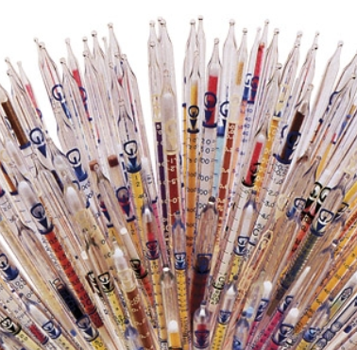
Content
Testing of Gas Detector Tubes
Product description
Test Method (ISO 17621:2015)
Test Equipment
Test Parameters
Calculation of Results
Summary and Conclusions

Slide 3
Disclaimer
Mention of company names or products does not constitute endorsement by HSE
The findings and conclusions in this presentation are those of the author and do not necessarily represent the views of HSE

Slide 4
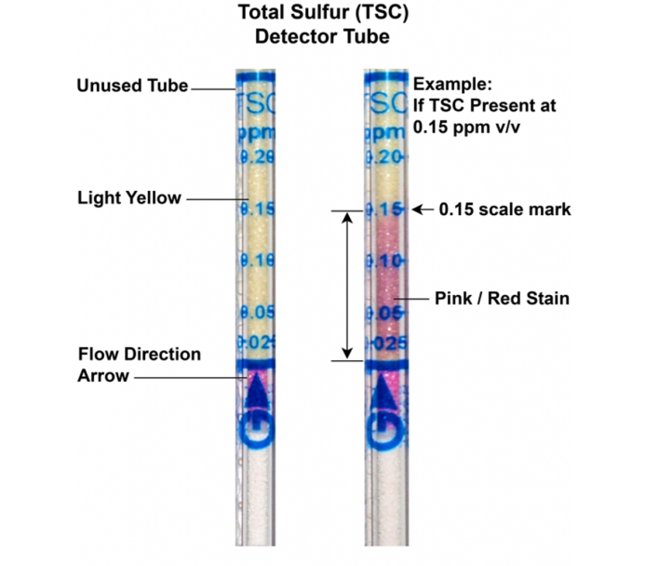
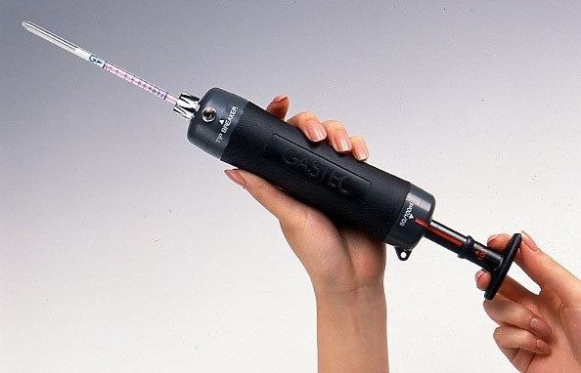
Product Description
Short Term Gas Detector Tubes comprise a
Stain Length Tube and a Sampling Pump
A known volume of air is drawn through the tube producing a colour change in the indicator layer the length of which is proportional to concentration

Slide 5
ISO17621:2015 Test Standard
Provides a Test Protocol for evaluation of both the Sampling Pump and the Detector Tube
Tests the detector tubes under a range of Concentrations, Temperatures and Humidities
Doesn’t consider Interferences
Results are used to calculate an Expanded Overall Uncertainty value
Acceptance criteria is an Expanded Overall Uncertainty of less than 50%

Slide 6
Testing of Sampling Pumps
The sampling pump test in ISO 17621 includes a leak test and a volume test
Volume measured a gas tight syringe, which must be both gas tight and low friction
Volume test is repeated six times
Acceptance Criteria is a deviation of less than 5% from the expected volume
Pump
Connector + Detector Tube
100 ml gas tight syringe

Slide 7
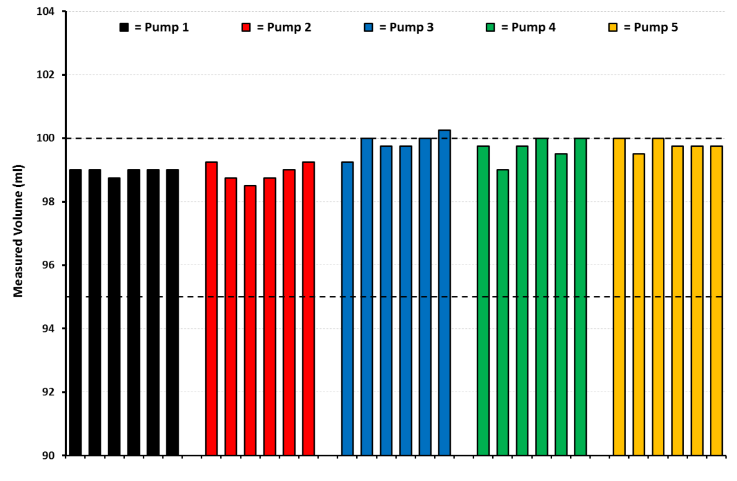
Results of Sampling Pump Tests
Five pumps tested
The average deviation from the expected volume of 100 ml was generally less than 1%
All five pumps therefore met the acceptance criteria in ISO 17621:2015

Slide 8
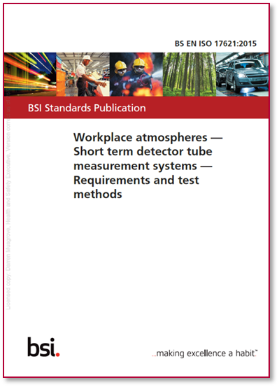
Tube Testing - Schedule
Evaluation in ISO 17621:2015 comprises six tests
Section 6.1.2.2 – Three tests
Fixed Temperature (20°C) & Humidity (50% RH)
Variable Concentration (20, 50 & 80% of Full Scale)
Section 6.1.2.4 – Three tests
Fixed Concentration (80% of Full Scale)
Variable Temperature (10 and 30°C) & Humidity (20 and 80% RH)
Four tube types were tested:
Benzene (5 - 60 ppm)
Trichloroethylene (0.25 – 4 ppm)
Sulfur Dioxide (0.2 - 5 ppm)
Ammonia (2.5 - 200 ppm)

Slide 9
Tube Testing - Equipment
Tube testing is carried out in a dynamic test atmosphere comprising:

Slide 10
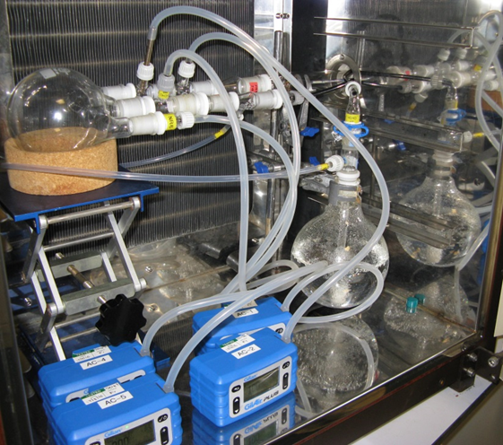
Tube Testing - Equipment
Tube testing is carried out in a dynamic test atmosphere comprising:
Test Chamber

Slide 11
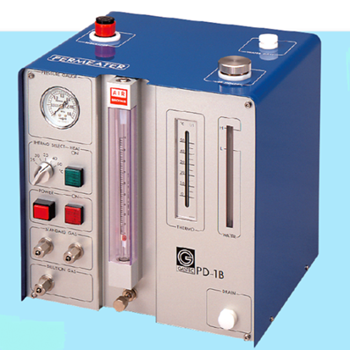
Tube Testing - Equipment
Tube testing is carried out in a dynamic test atmosphere comprising:
Test Chamber
Gas Generation System

Slide 12
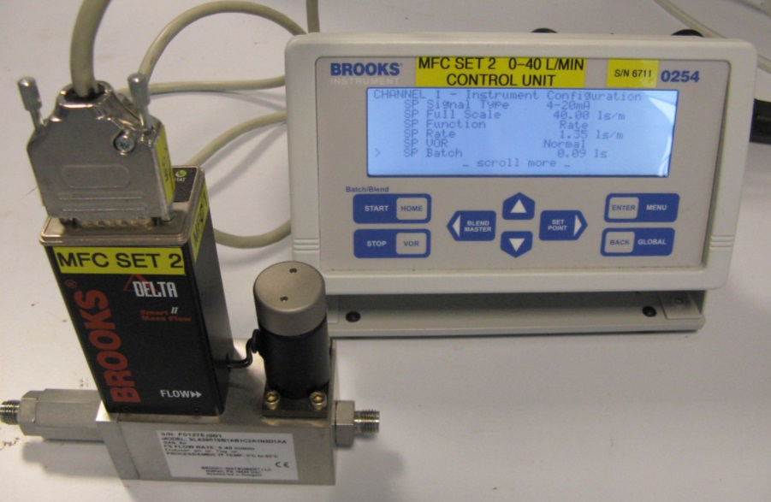
Tube Testing - Equipment
Tube testing is carried out in a dynamic test atmosphere comprising:
Test Chamber
Gas Generation System
Dilution System
(Mass Flow Controllers)

Slide 13
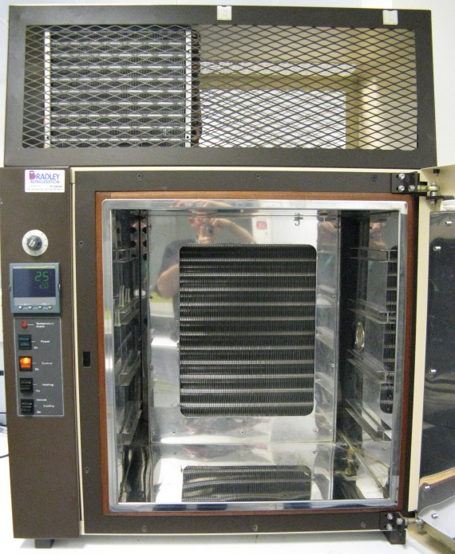
Tube Testing - Equipment
Tube testing is carried out in a dynamic test atmosphere comprising:
Test Chamber
Gas Generation System
Dilution System
(Mass Flow Controllers)
Temperature Control System
(Thermostatic Oven)

Slide 14
Tube Testing - Equipment
Tube testing is carried out in a dynamic test atmosphere comprising:
Test Chamber
Gas Generation System
Dilution System
(Mass Flow Controllers)
Temperature Control System
(Thermostatic Oven)
Humidity Control System
(Humidifier)

Slide 15
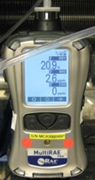
Tube Testing - Equipment
Tube testing is carried out in a dynamic test atmosphere comprising:
Test Chamber
Gas Generation System
Dilution System
(Mass Flow Controllers)
Temperature Control System
(Thermostatic Oven)
Humidity Control System
(Humidifier)
Independent Means of Verifying Concentration
(Real Time Devices; Sorbent Tubes)

Slide 16
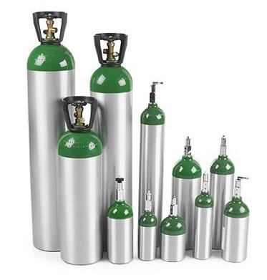
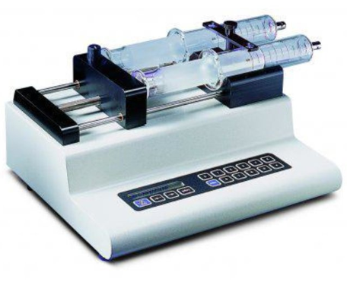
Gas Generation Methods
1. Syringe Injection
2. Bottled Gases
3. Permeation / Diffusion
Tubes

Slide 17
Gas Generation Methods
1. Syringe Injection
Can be used over a range of concentrations
Good for volatile compounds,
e.g. Benzene and Trichloroethylene
Good for multicomponent liquids
Requires the use of a heated injection port (and other accessories)
Not suitable for very volatile liquids or analytes that are gaseous at room temperature,
e.g. Sulfur Dioxide and Ammonia

Slide 18
Gas Generation Methods
2. Bottled Gases
Least flexible option
Can be (very) expensive
Limited capacity (life)
Large cylinders are bulky
Some safety issues when used in a laboratory environment

Slide 19
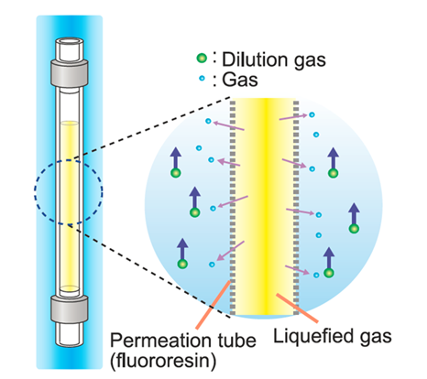
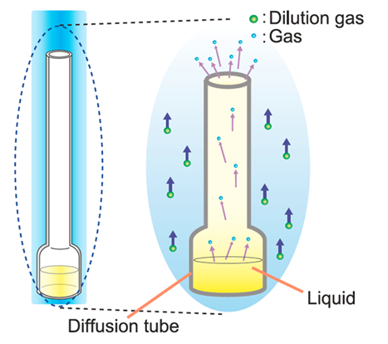
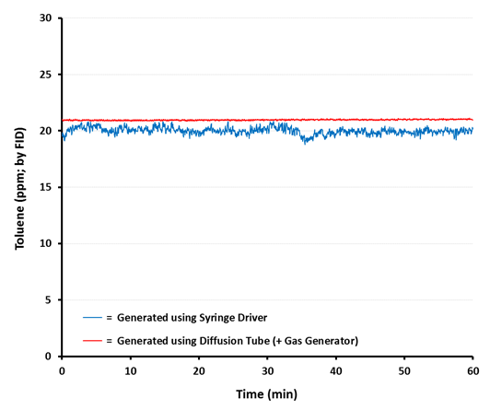
Gas Generation Methods
3. Permeation / Diffusion
Tubes
Suitable for a wide range of test compounds
Incorporates flow and temperature control
Good stability, simple to use and reproducible
Permeation Tubes
Used for compounds that are Gases at room temp.
e.g. Sulfur Dioxide and Ammonia
Diffusion Tubes
Used for compounds that are Liquids at room temp.
e.g. Benzene and Trichloroethylene

Slide 20
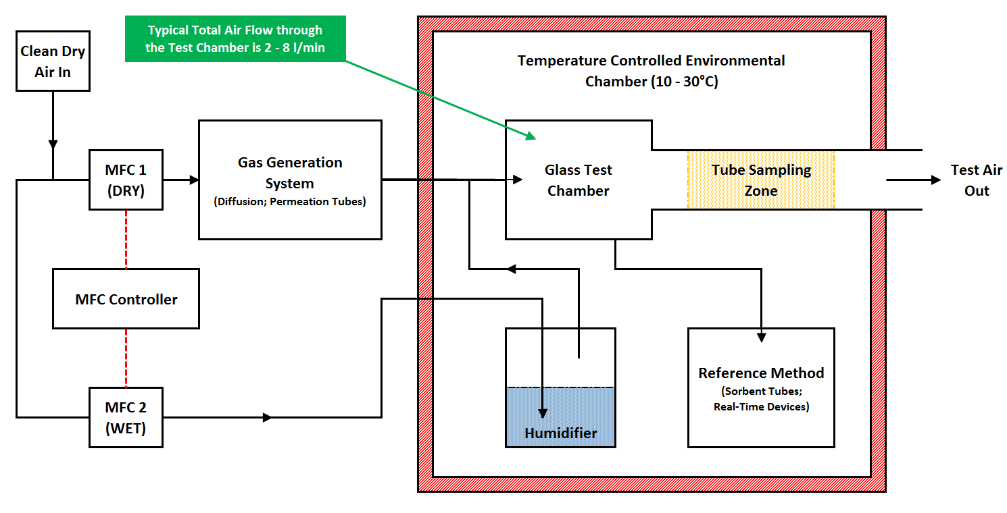
Dynamic Test Atmosphere

Slide 21
How to Vary Concentration
Ammonia | Test 1 | Test 2 | Test 3 | Test 4 | Test 5 | Test 6
NH₃ (ppm)* | 80 | 50 | 20 | 80 | 80 | 80
T (°C) | 20 | 20 | 20 | 10 | 30 | 30
RH (%) | 50 | 50 | 50 | 20 | 20 | 80
MFC 1 (l/min) - Dry | 0.83 | 1.33 | 3.35 | 1.31 | 1.38 | 0.35
MFC 2 (l/min) - Wet | 0.83 | 1.33 | 3.35 | 0.33 | 0.35 | 1.38
Total (l/min) | 1.66 | 2.66 | 6.70 | 1.64 | 1.73 | 1.73
Flow Ratio | 1.00 | 1.00 | 1.00 | 3.97 | 3.94 | 0.25
* = Based on the stated Permeation Rate of Ammonia, from four 10 cm tubes at 35°C, of 94.3 µg/min
Change total flow but keep wet:dry flow ratio constant

Slide 22
How to Vary Relative Humidity
Ammonia | Test 1 | Test 2 | Test 3 | Test 4 | Test 5 | Test 6
NH₃ (ppm)* | 80 | 50 | 20 | 80 | 80 | 80
T (°C) | 20 | 20 | 20 | 10 | 30 | 30
RH (%) | 50 | 50 | 50 | 20 | 20 | 80
MFC 1 (l/min) - Dry | 0.83 | 1.33 | 3.35 | 1.31 | 1.38 | 0.35
MFC 2 (l/min) - Wet | 0.83 | 1.33 | 3.35 | 0.33 | 0.35 | 1.38
Total (l/min) | 1.66 | 2.66 | 6.70 | 1.64 | 1.73 | 1.73
Flow Ratio | 1.00 | 1.00 | 1.00 | 3.97 | 3.94 | 0.25
* = Based on the stated Permeation Rate of Ammonia, from four 10 cm tubes at 35°C, of 94.3 µg/min
Change wet:dry flow ratio but keep total flow constant

Slide 23
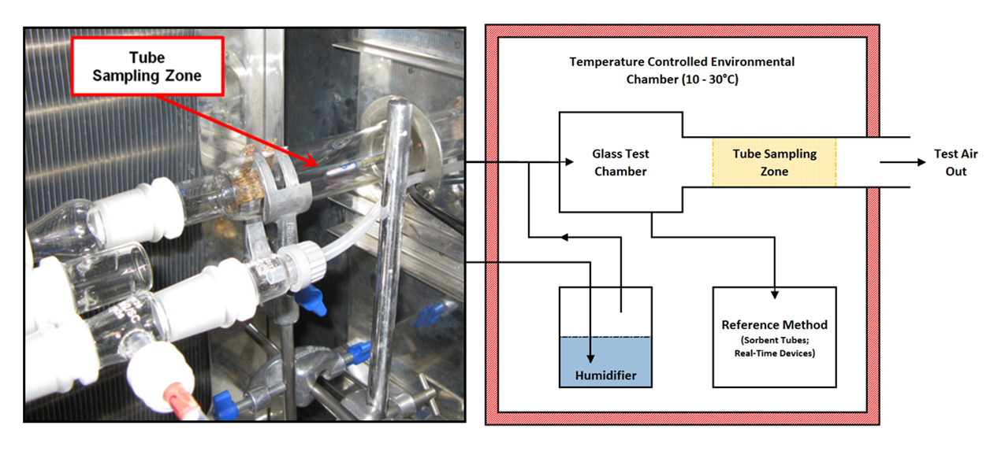
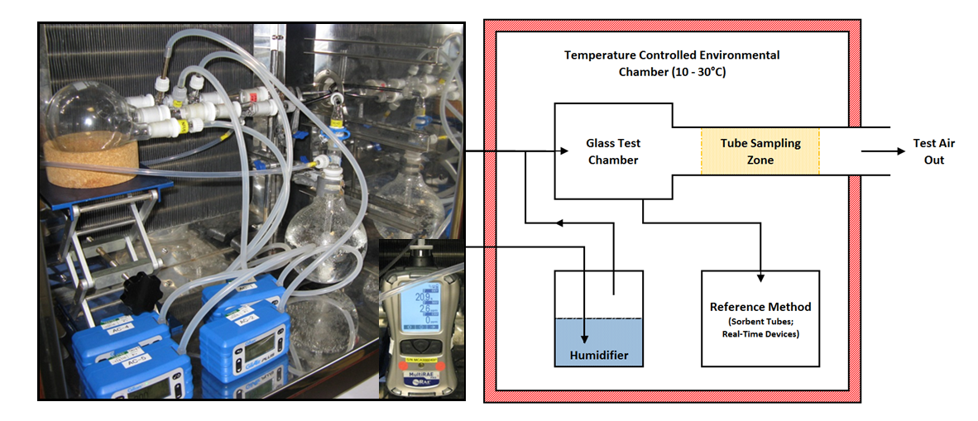
Dynamic Test Atmosphere

Slide 24
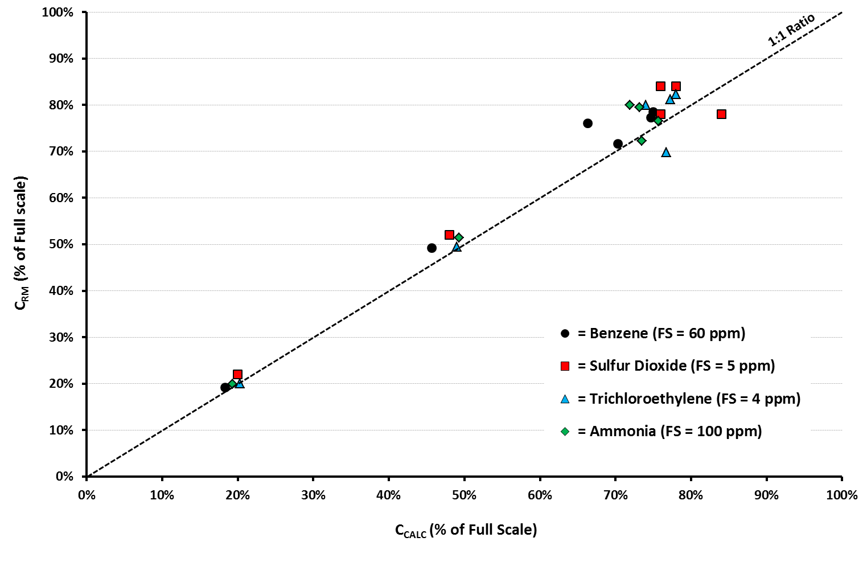
Test Atmospheres

Slide 25
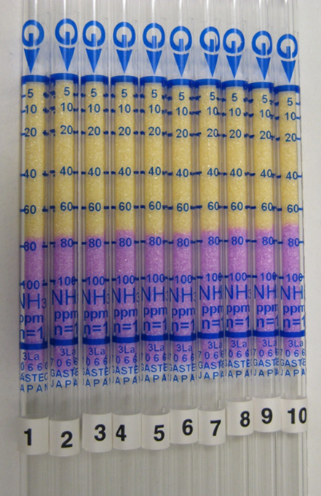
Additional Test Parameters
10 tubes used in each test
Tubes tested following the manufacturer ‘Instructions for Use’
Tubes conditioned at the test temperature for 1-hour immediately prior to use (and for a further 1-minute in the test atmosphere immediately before sampling)
Concentration (Stain Length) determined immediately after sampling
If required a temperature correction was applied to give a final concentration result for each tube

Slide 26
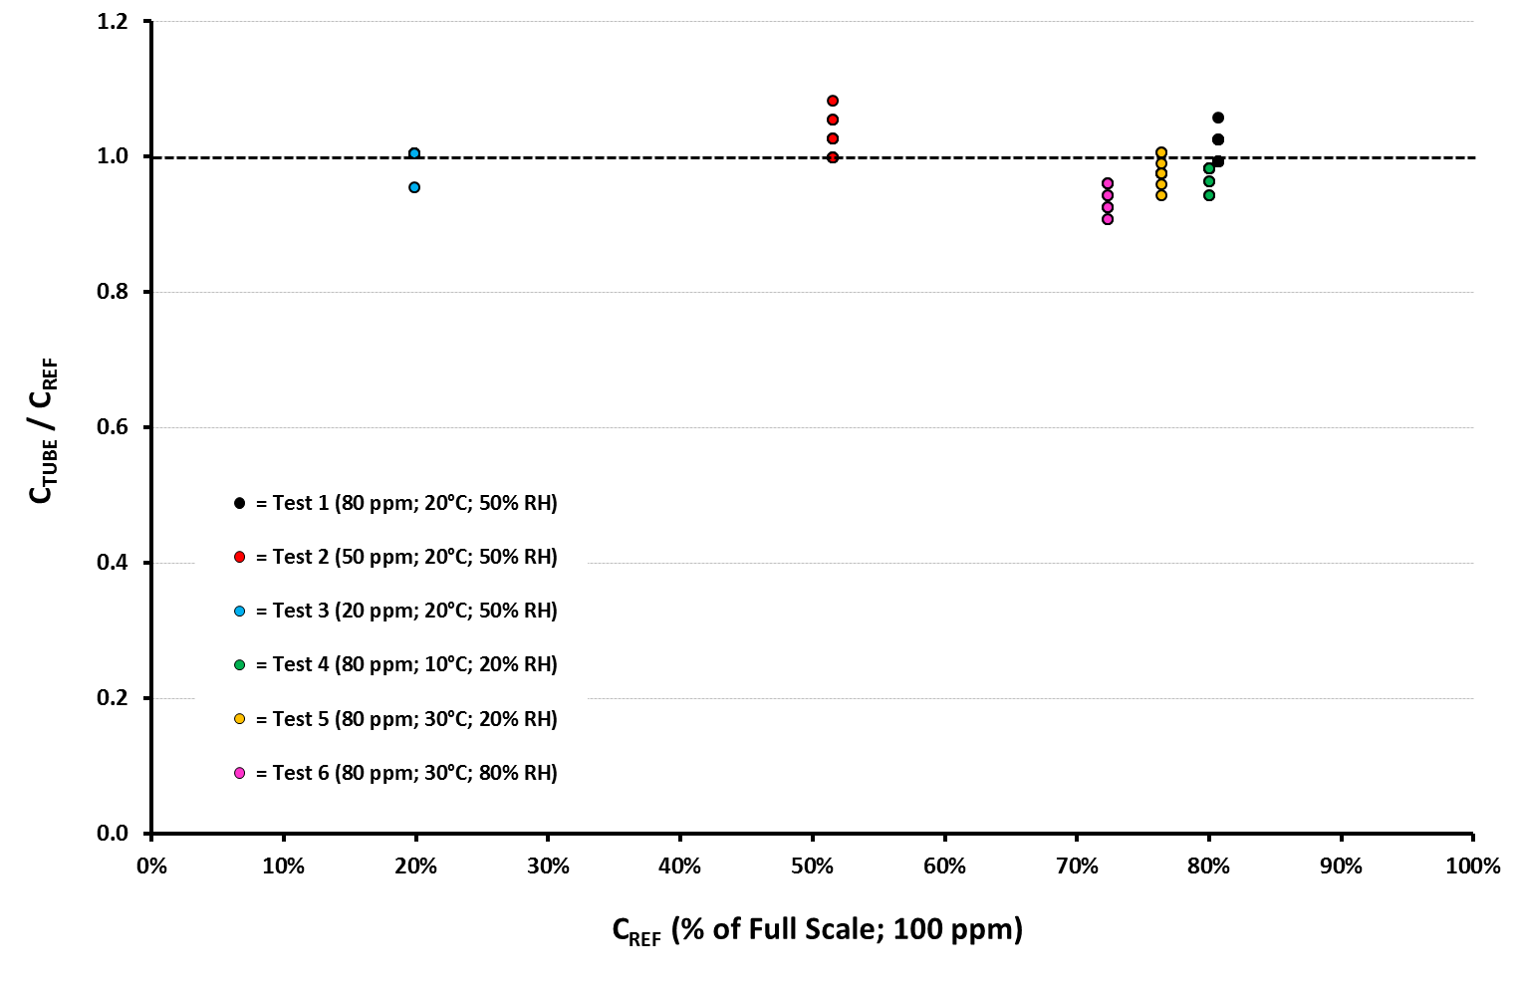
Test Results (1)
Ammonia Tube

Slide 27
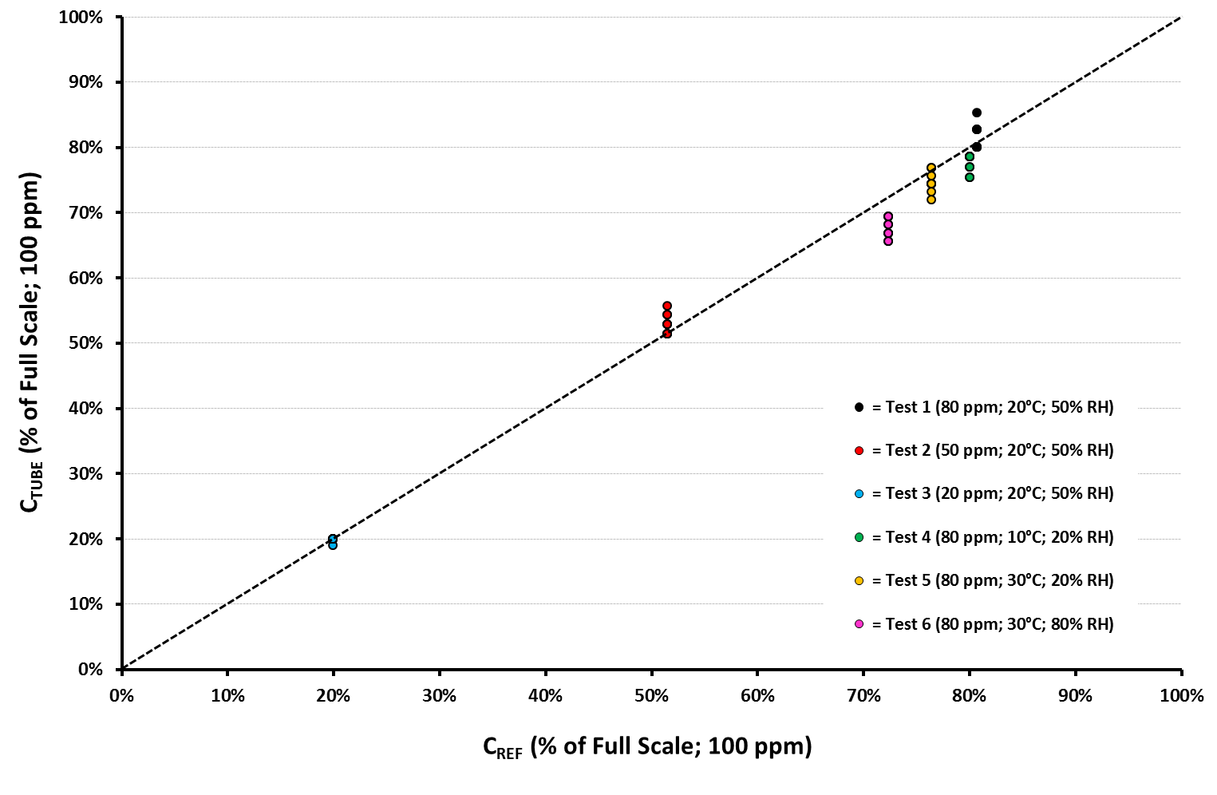
Test Results (2)
Ammonia Tube

Slide 28
Calculation of Uncertainty
Expanded Uncertainty (U)
$U= k×u_{C}$ (where k = 2)
Combined Standard Uncertainty (u_{c})
$$u_{C}=\sqrt{u_{S}^{2}+u_{T}^{2}+u_{H}^{2}+u_{B}^{2}+u_{P}^{2}+u_{EC}^{2}}$$
where:
u_{S} is the uncertainty due to Concentration
u_{T} is the uncertainty due to Temperature
u_{H} is the uncertainty due to Humidity
u_{B} is the uncertainty due to Bias
u_{P} is the uncertainty due to Pump Volume
u_{EC} is the uncertainty due to Test Gas Concentration

Slide 29
Calculation of Tube Performance
Results for Ammonia Detector Tube
C (ppm) | u_{S} (Conc) | u_{T} (Temp) | u_{H} (RH) | u_{B} (Bias) | u_{P} (Pump) | u_{EC} (Ref) | u_{C} (CSU) | U (EU)
80 | 0.028 | -0.009 | -0.028 | 0.071 | 0.005 | 0.025 | 0.086 | 17%
50 | 0.023 | -0.009 | -0.028 | 0.111 | 0.005 | 0.025 | 0.120 | 24%
20 | 0.016 | -0.009 | -0.028 | 0.034 | 0.005 | 0.025 | 0.054 | 11%
C (ppm) | u_{S} (Conc) | u_{T} (Temp) | u_{H} (RH) | u_{B} (Bias) | u_{P} (Pump) | u_{EC} (Ref) | u_{C} (CSU) | U (EU)
80 | 0.028 | -0.009 | -0.028 | 0.071 | 0.005 | 0.025 | 0.086 | 17%
50 | 0.023 | -0.009 | -0.028 | 0.111 | 0.005 | 0.025 | 0.120 | 24%
20 | 0.016 | -0.009 | -0.028 | 0.034 | 0.005 | 0.025 | 0.054 | 11%
C (ppm) | u_{S} (Conc) | u_{T} (Temp) | u_{H} (RH) | u_{B} (Bias) | u_{P} (Pump) | u_{EC} (Ref) | u_{C} (CSU) | U (EU)
80 | 0.028 | -0.009 | -0.028 | 0.071 | 0.005 | 0.025 | 0.086 | 17% | J
50 | 0.023 | -0.009 | -0.028 | 0.111 | 0.005 | 0.025 | 0.120 | 24% | J
20 | 0.016 | -0.009 | -0.028 | 0.034 | 0.005 | 0.025 | 0.054 | 11% | J
The main factor affecting Expanded Uncertainty (U) in this example
is Measurement Bias (U_{B})
If U < 50% then the tube is within the required expanded uncertainty stated in
ISO 17621:2015 and EN 482

Slide 30
Summary
Testing to ISO 17621:2015 provides a standard method of assessing the performance of short term gas detector tubes
With the right equipment the test procedure is straight forward to carry out
Diffusion and permeation tubes in a gas generator provide a safe and simple method of generating dynamic test atmospheres for a wide range of analytes
Reliable temperature control of the test atmosphere is vital
The four tubes tested (and the sample pump) produced satisfactory results when evaluated against the ISO standard using the test equipment
The main factor found to affect tube performance was measurement bias (u_{B})

Slide 31
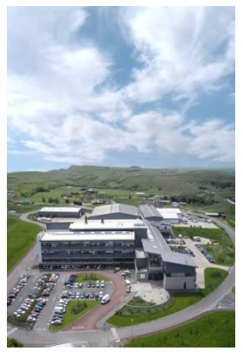
Any questions?
The work described in this presentation was carried out at the Science and Research Centre of the Health and Safety Executive at the request of Gastec Corporation, Ayase-City, Japan. Gastec also supplied the tubes tested.
For further information please contact:
ian.pengelly@hse.gov.uk
Analytical Chemistry Team
Health and Safety Executive
Science and Research Centre
Harpur Hill, Buxton, SK17 9JN
United Kingdom

